Slide 1

Jim’s Gym
CA Project
Martin McCarthy
Carl Taylor
Felix Ogiehor

Slide 2
The Front End
Martin McCarthy

Slide 3
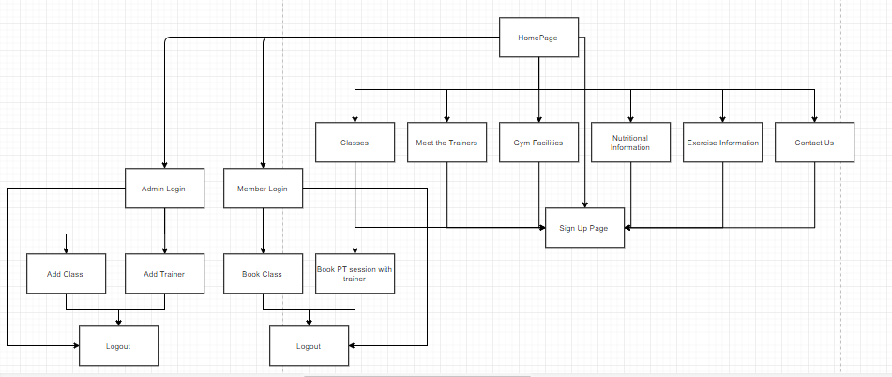
Structural Hierarchy

Slide 4

We used Bootstrap 4, this gave us a lot of flexibility
Homepage – little information design to grab your attention, and to encourage further exploration

Slide 5
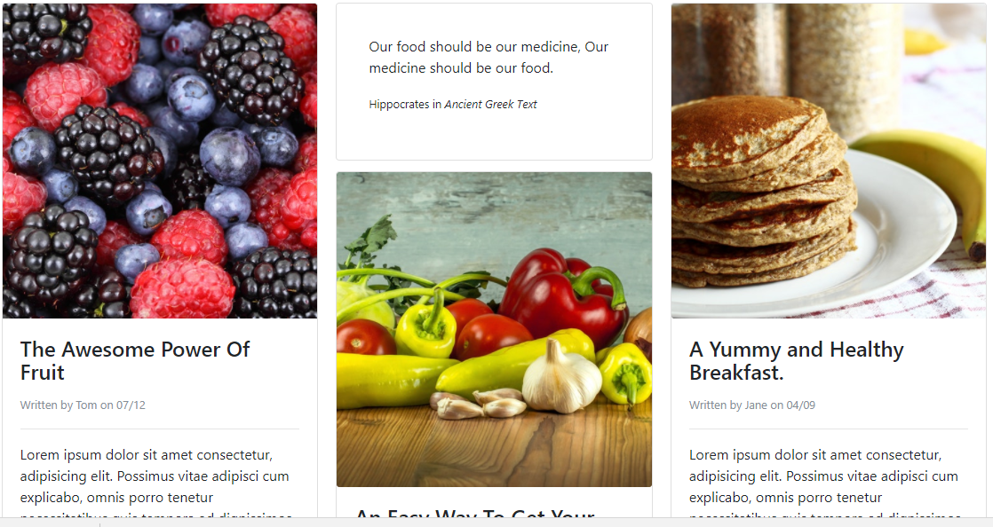

Slide 6
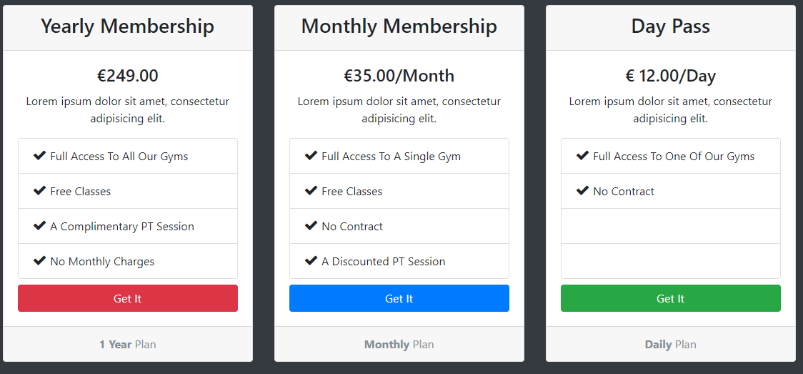

Slide 7
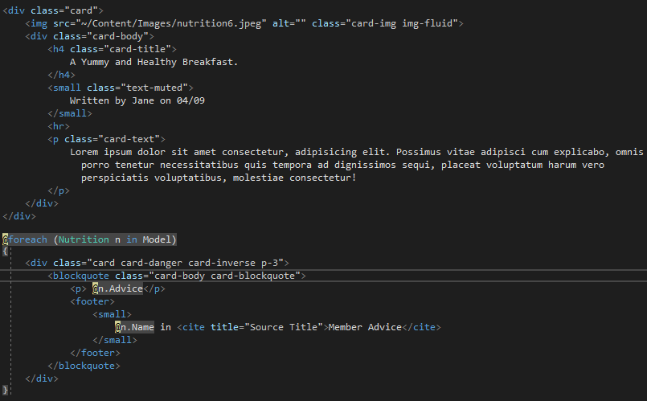

Slide 8
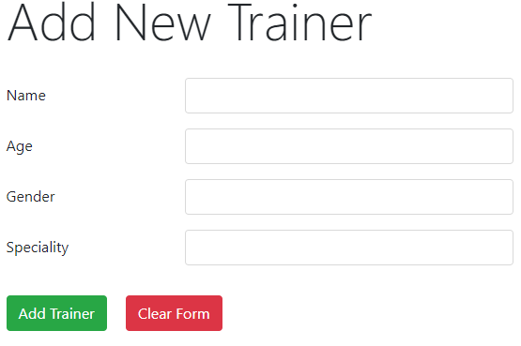
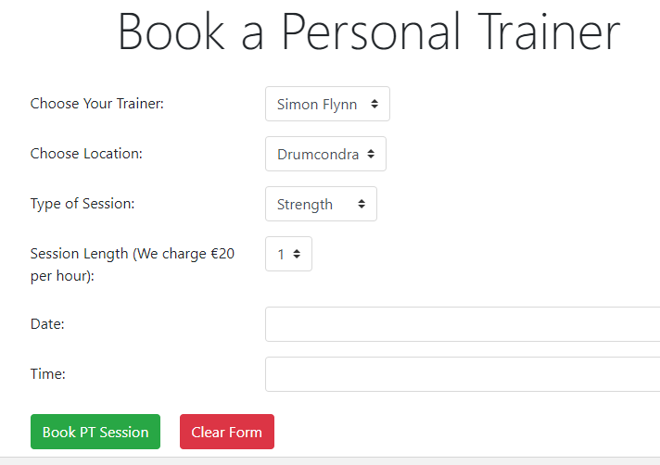

Slide 9
The Back End
Carl Taylor + Felix Ogiehor

Slide 10
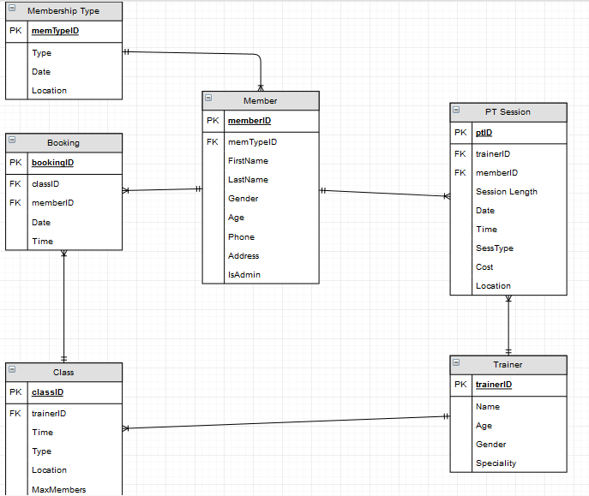
The ERD
We created the trainer table first as this required no foreign keys. Then we worked backwards from there
Planning the structure of foreign keys was the most important part. We figured this out towards the end!

Slide 11
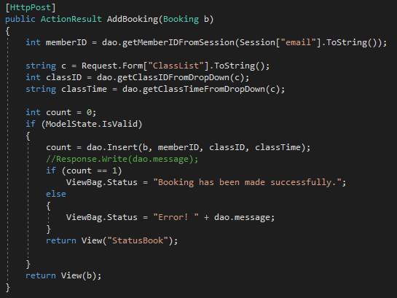
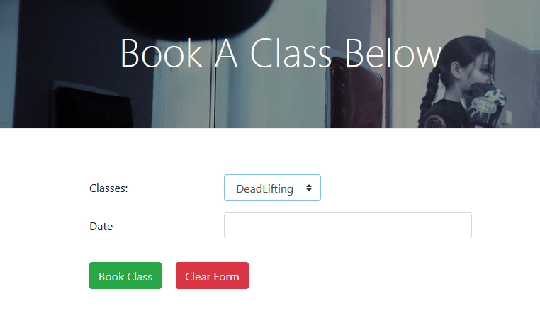
Dynamic Web Pages
When a member creates a booking, we grab there session email and the information from the class they selected, from the database and populate our new booking record.
Lists are dynamically generated using the SQL Database

Slide 12
XML
Felix Ogiehor + Carl Taylor

Slide 13


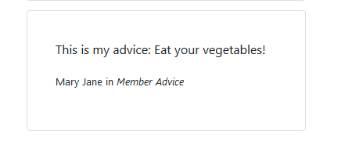
XML
The text is saved to an xml. This xml file is then read to our Nutrition Page.
A member can add their own nutritional blog post to our site. This dynamically uses their logged in session to grab their first and last name.

Slide 14
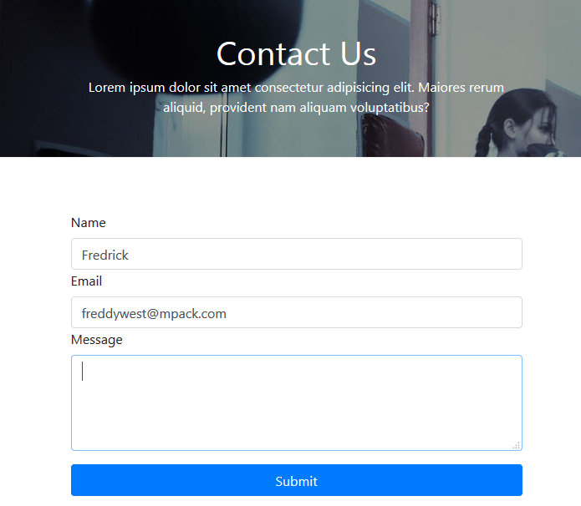

XML
Any visitor to the site can initially send a message with these given details.
This is then stored in an xml document to be extracted by the admin.

Slide 15
Access
On The Cloud
On Github
http://jimsgym.azurewebsites.net/
Uploaded using azure.
https://github.com/Madmurt/CA-ASP.NET-MVC-Project
Continuously worked on and integrated.

Slide 16

Any Questions

